Slide 1
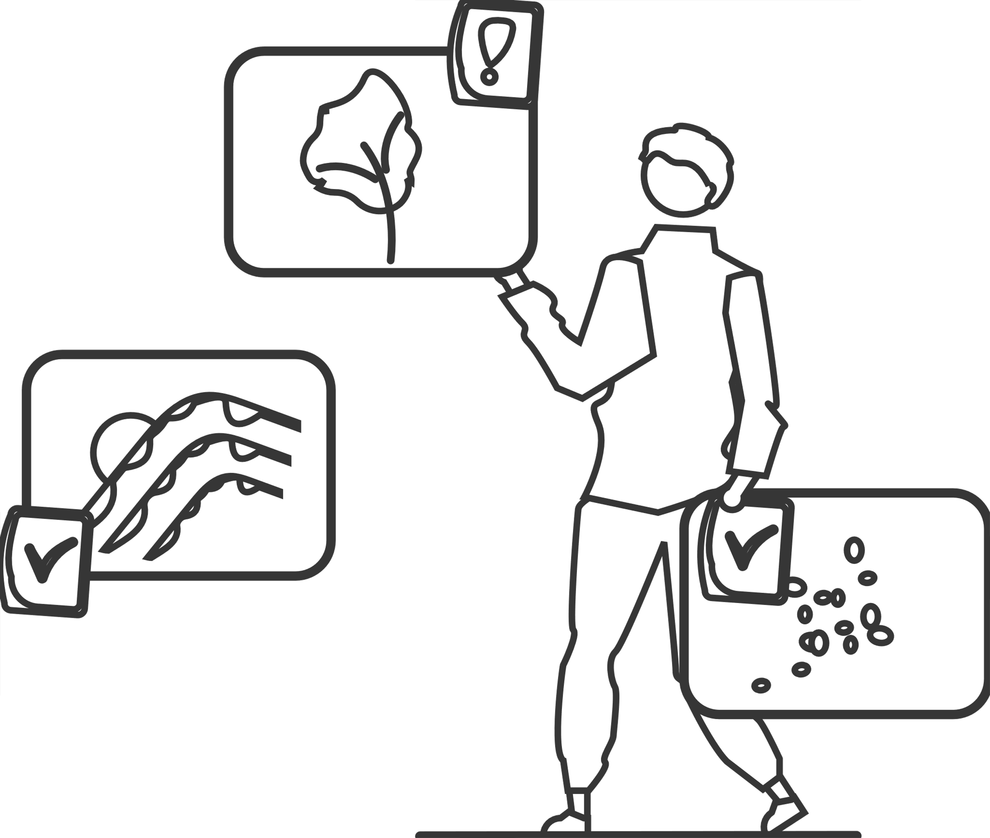
论文分享
Exploring Lemma Interconnections in Historical Dictionaries
Li Fan
2022.6.24

Slide 2
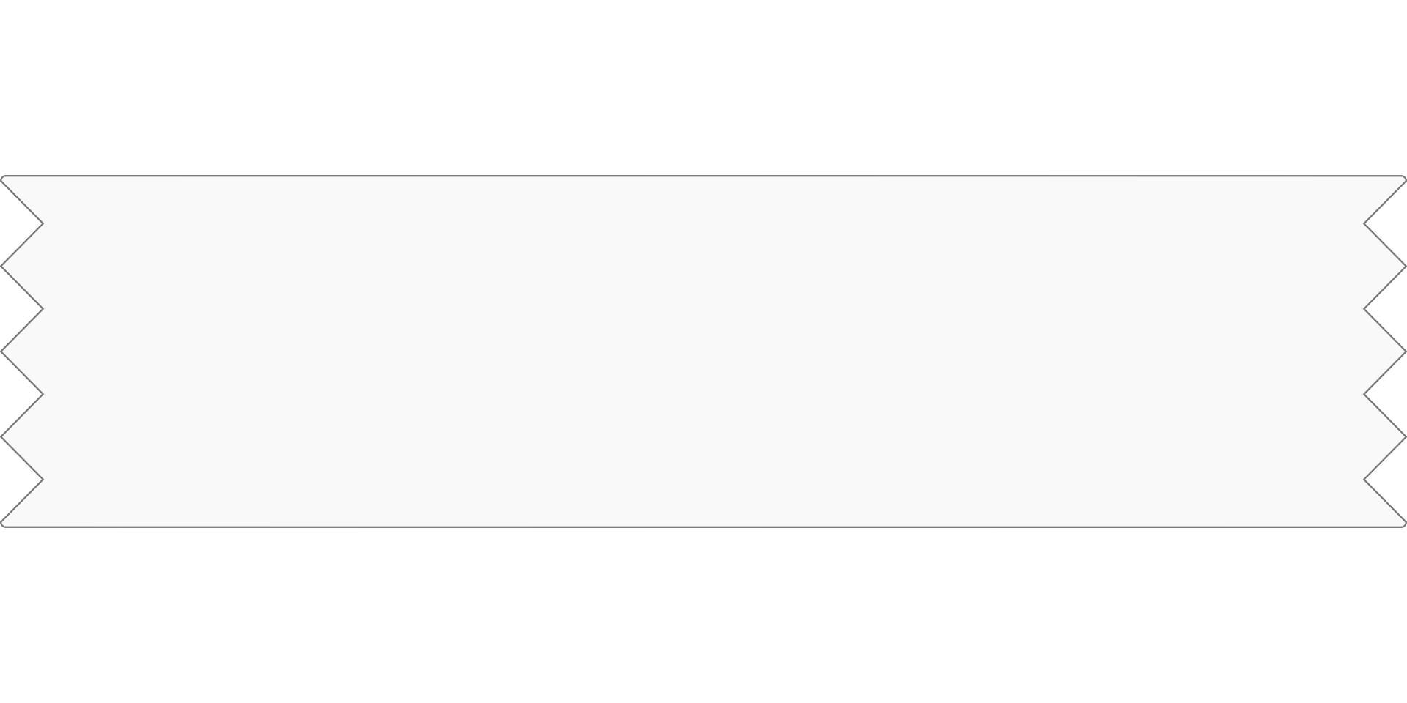
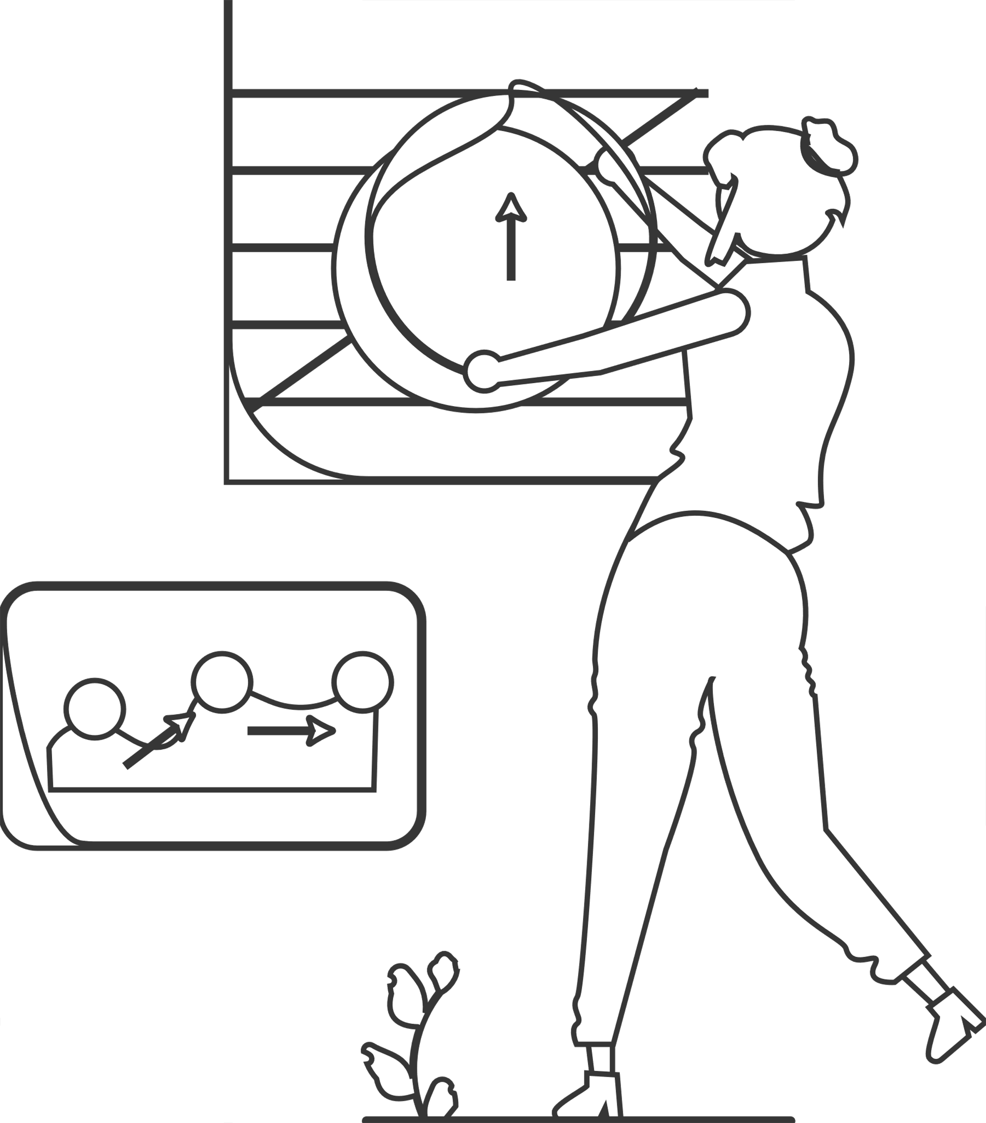
Content
1.Introduction
2.Related Work（Preparation）
3.Detail
4.Discussion & Prediction

Slide 3

PART-1
Introduction

Slide 4



Goal
A visual exploratory analysis tool for historical dictionaries of the Bavarian dialects in Austria
Dataset
Target
Task
The digitized version of the Historical Dictionary of Bavarian Dialects in Austria
1. Scholars
2. General public
1. Spatial-temporal
analysis
2. Fast full-text
search
3. Network Analysis

Slide 5
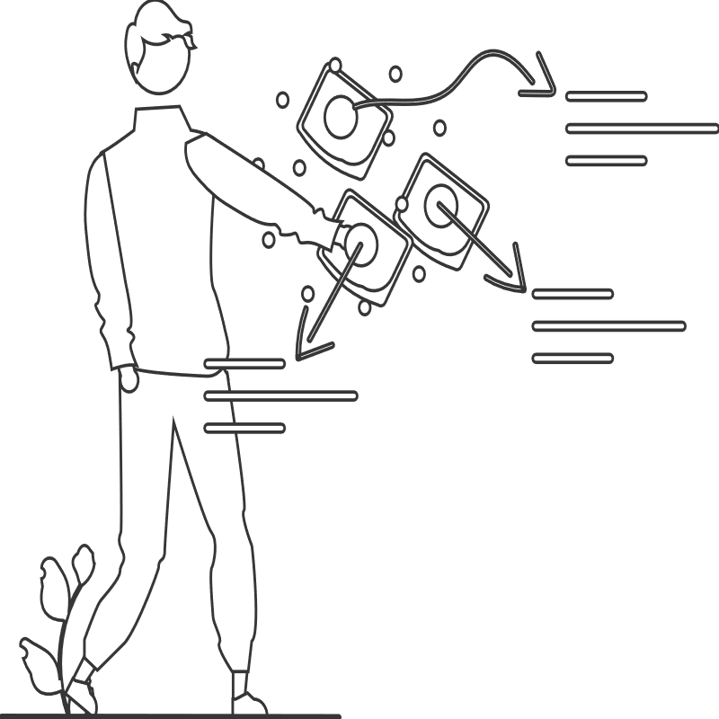
PART-2
Related Work（Preparation）

Slide 6

Inspiration
1. One of the first attempt
4. Bernard
ad-hoc search
String search
An overview visualization
2. John & Jaehnichen
5. Mayer
Deal with the text-base material
Network analysis
3. EMNON
6. Famous Quotes
Visual analysis + Social network
Analyze first, show the important, zoom, filter and analyze further, then details on demand
(Workflow)

Slide 7
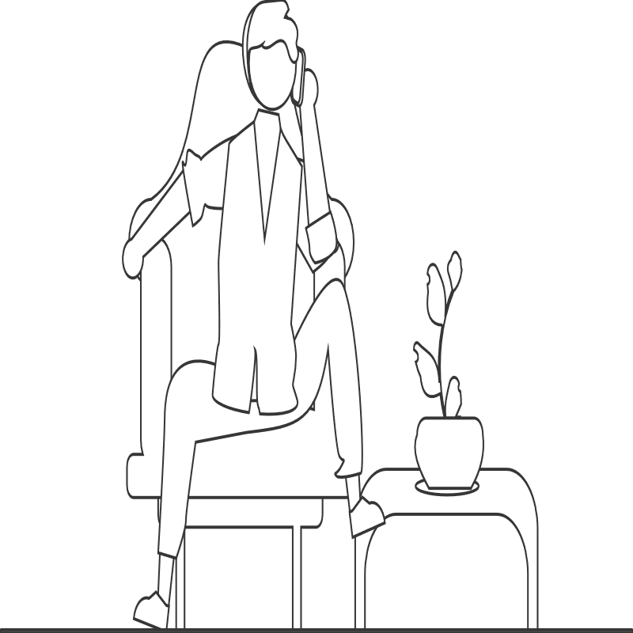
PART-3
Detail——
1. Pilot visualization tool
2. Application

Slide 8
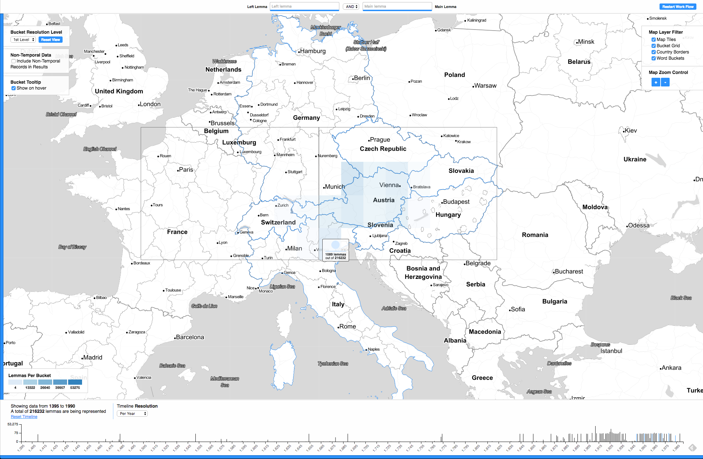
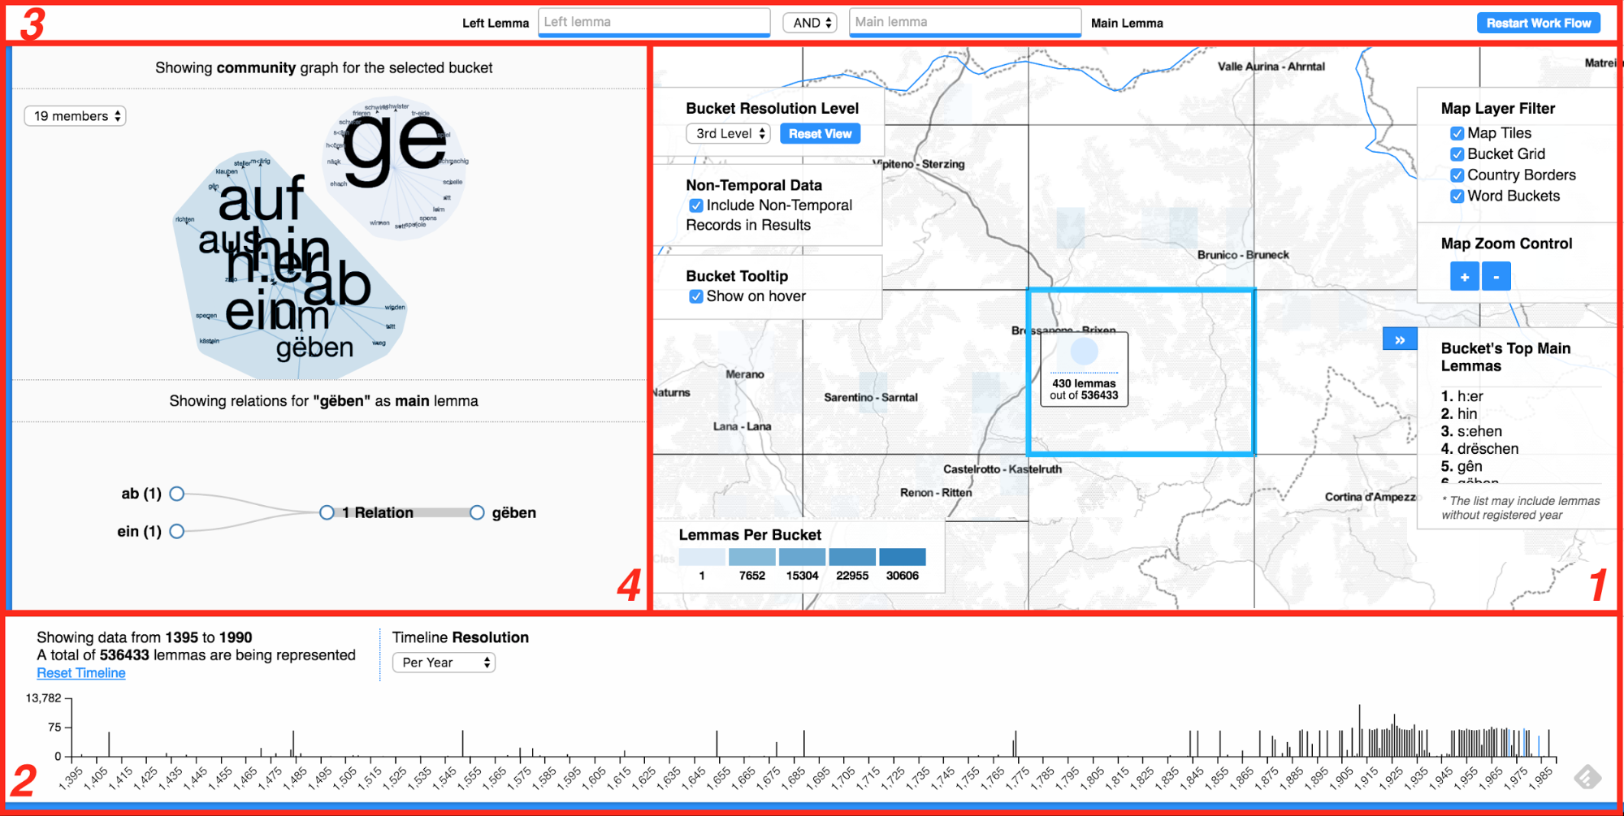
Pilot visualization tool
View 1：Spatial
Supports the panning, zooming and filtering by selecting specific visual elements on the map
View 2：Timeline
Link to the spatial view, represent temporal
information
View 3：Textual search bar
Collect the text queries performed by the user Filtering is performed on each user keystroke
Four Views
View 4： Network analysis
This view relates to timeline and textual search
The top view —— a modified force directed graph that represents lemma co-occurrences
The bottom view——sorts such occurrences in numerical order for an specific lemma, depending on its role withing the words (prefix or lexeme)
only three are made available from the beginning to the user

Slide 9
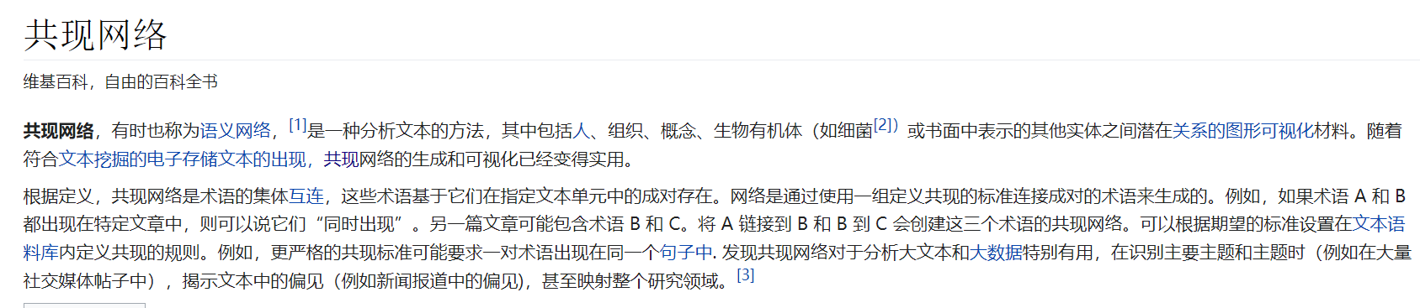
Pilot visualization tool
Co-occurrences
A search engine for the dictionaries
Key features: Full-text search & Web-ready piece of software
——chose Apache-licensed ElasticSearch documental search engine
Advantages:
1. Adapt very well to work in a web environment
2. A suitable solution for indexing and querying our data, compare with other DH practitioners
3. Offer the possibility to obtain summaries of the response data sets by using aggregations
——the common tasks of querying data and obtaining summaries performed substantially faster in comparison

Slide 10
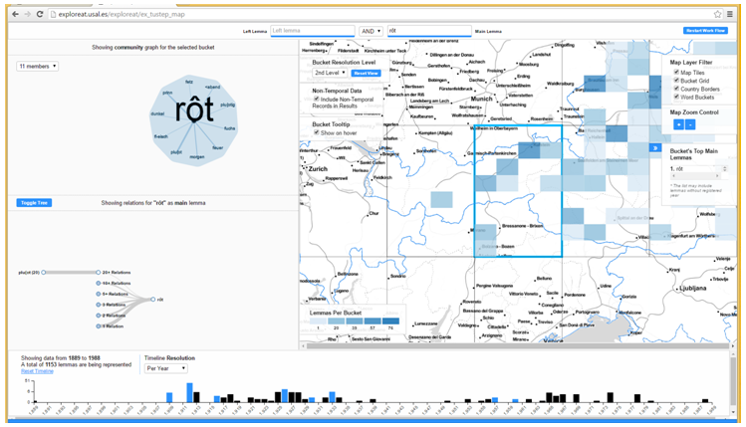
Application
—— Colour (an integral part of our lives & important in cultural knowledge) term usage
Input
Look associations of red (rot) with other terms
Solution
1. Rot ——lexeme input box
2. Spatial view presented
3. selected a bordering area & NA
Result
Notice how the geographical area for which NA is run is highlighted in the map
Lexeme——a unit of lexical meaning roughly corresponds to a set of forms taken by a single root word （run, runs, ran and running are forms of the same lexeme, which can be represented as run）

Slide 11
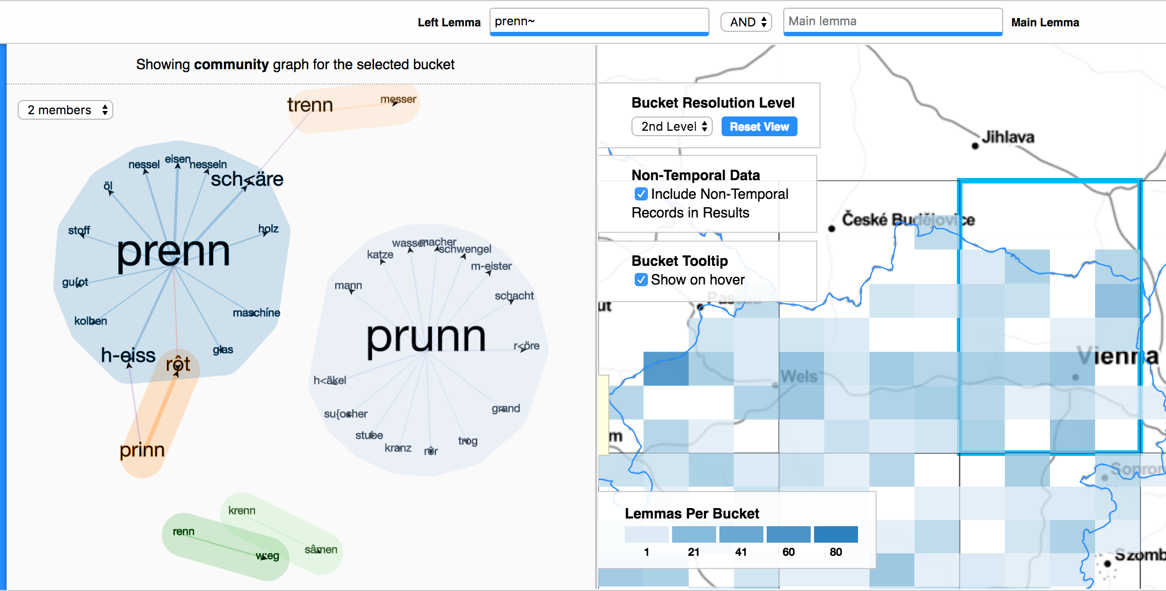
Application
—— Using fuzzy searches to find similar headword pronunciations
(One of the top combinations of red : the lemma “prinn”)
Fuzzy Search
1. Returns results ——headwords containing this particle at the beginning of the compound word
(vowels——high variability）”~”
2. Varied in maximum 1 character
NA result
1. Prenn & Prinn community
2. Prenn & Prinn community
3. Prenn & Trenn community

Slide 12

PART-4
Discussion
& Prediction

Slide 13
Problems
Time inaccuracy
Larger database
Some of the sources in the study could not be dated accurately by automatic means, while others presented incomplete or missing information
Solution: Clustering
Indirect connection
Overlapping node
Certain degree of detachment (in interface terms) between the elements in the NA area (and more specifically, the graph nodes) and their counterparts on the map.
Solution: Creating a new visualization that allows spatial and network analysis to be performed using the same visual elements and areas of the screen
Treatment of overlapping nodes in the graph has not been addressed yet
Possible solution : collision detection

Slide 14
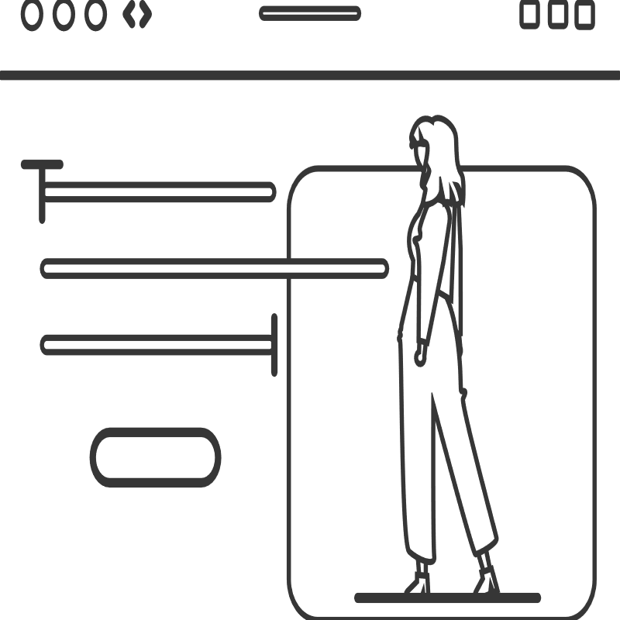
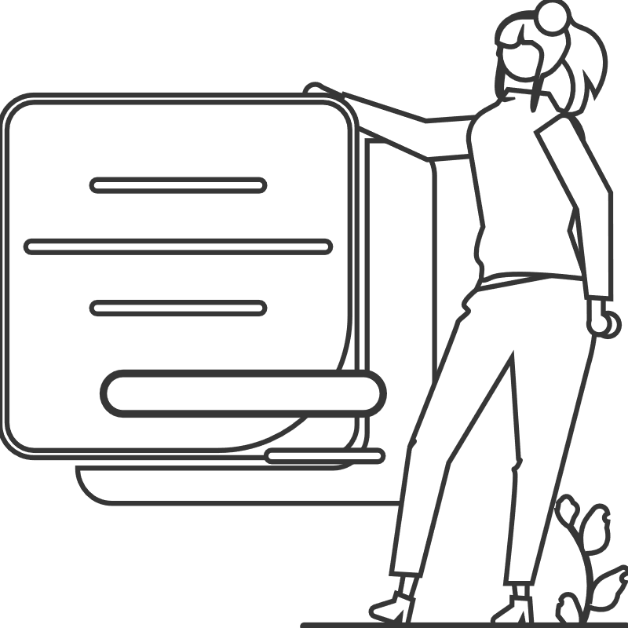
Thank you for listening

